Slide 1
Team DELTA
UNIT-E
Swapnil - 8102149044
Prakhar Pratyush - 9006611133

Slide 2
Description of the Project
Problem Statement
Approach to the Solution
Need to visit multiple sites and apps for performing tasks that are of similar background.
A centralised institute Web App including all the important features that student can perform for the smooth functioning of College Academic life.
Relevance to the Theme
Techstack Involved
Under Open Innovation
HTML, CSS, JavaScript, Django

Slide 3
Details of Technology Stack
To create the layout of a complete responsive web app, used as Frontend.
HTML, CSS, JS
To enable features like cards and carousel for enabling Newsfeed, Time table and many more.
Bootstrap
Python web framework used as Backend.
Django
To collect all the necessary data across various websites.
API

Slide 4
Description of the Solution
Step 1
Step 2
Used Frontend tools (HTML, CSS, JS, Bootstrap) to create the layout of the web app.
Used Django for Backend
to interact with the user.
2021
Step 3
Step 4
Fetched data from APIs of various sites and represented it on the web app.
A progressive web app with adaptability for APK format.

Slide 5
Novelty of the Solution
Our product has multiple features that benefit our client i.e, students in following ways : 1. It makes it easy for the students to manage their campus lives, as we are providing features like newsfeed, personalised routine , notice and many more. 2. It will be a PWA (Progressive Web App) having support for APK format as well as for desktop.

Slide 6
Growth Plan of the Product
UNIT-E
60%
Add more features like attendance manager,
deadline alerts and many more on upcoming updates.
Checkpoint 1
40%
Implementing the product to multiple college levels.
Checkpoint 2

Slide 7
Business Aspects of the Hack
01
Market Impact
It supports the open source community which is the need of the hour in the era of financial hustle.
Target Consumers
02
Our product is aimed for the students of NIT Hamirpur, to make it easy for them to manage their campus related activities.
03
Financial Sustainability
Completely open source for the benefit of student community with zero monetary charges.
Product > Project
04
Developed an .apk file which will further be distributed among students with timely updates.

Slide 8
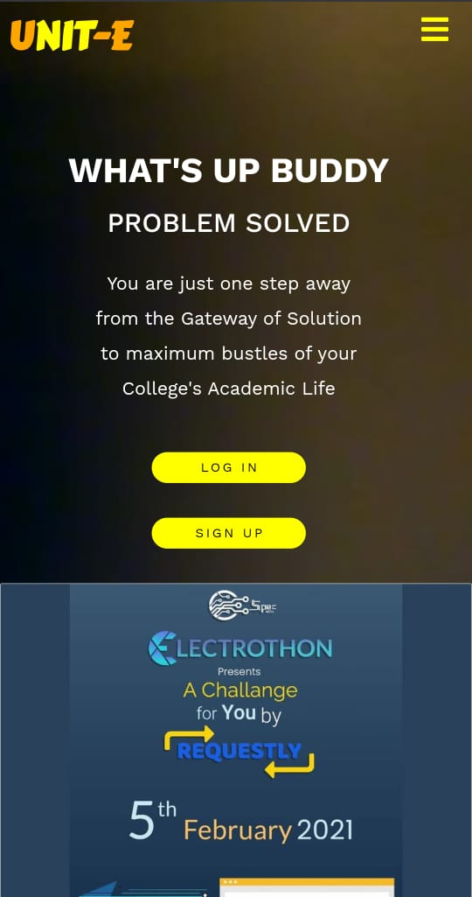
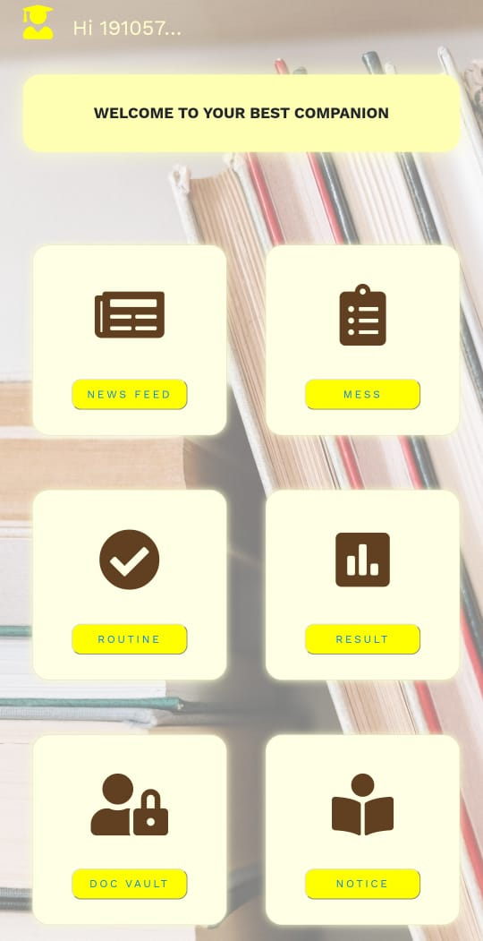
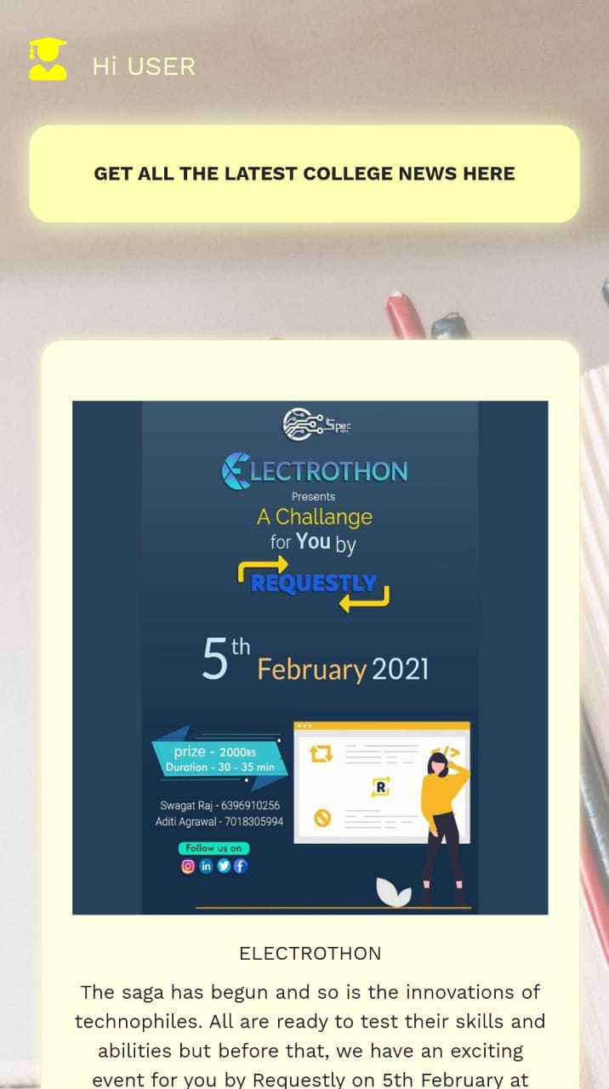
Work in Progress...
Home Page
Features
NewsFeed

Slide 9
Learning Curve
What have you learnt by doing this project?
01
Frontend
Learnt HTML, CSS, Javascript and Bootstrap for frontend.
02
Django
Learnt using Django as a backend framework.
03
APIs
Fetching data from APIs and representing it on the web app.
04
Web scraping
Scraping data from NITH website using python’s requests library.

Slide 10
About Team
01
02
Swapnil
Prakhar Pratyush
Developed Frontend of the web app.
Developed Backend of the web app.

